Slide 1
Topic 8 – Text Modelling
Data Science for Business
Prof: Chris Volinsky
NYU Stern: Spring 2025

Slide 2
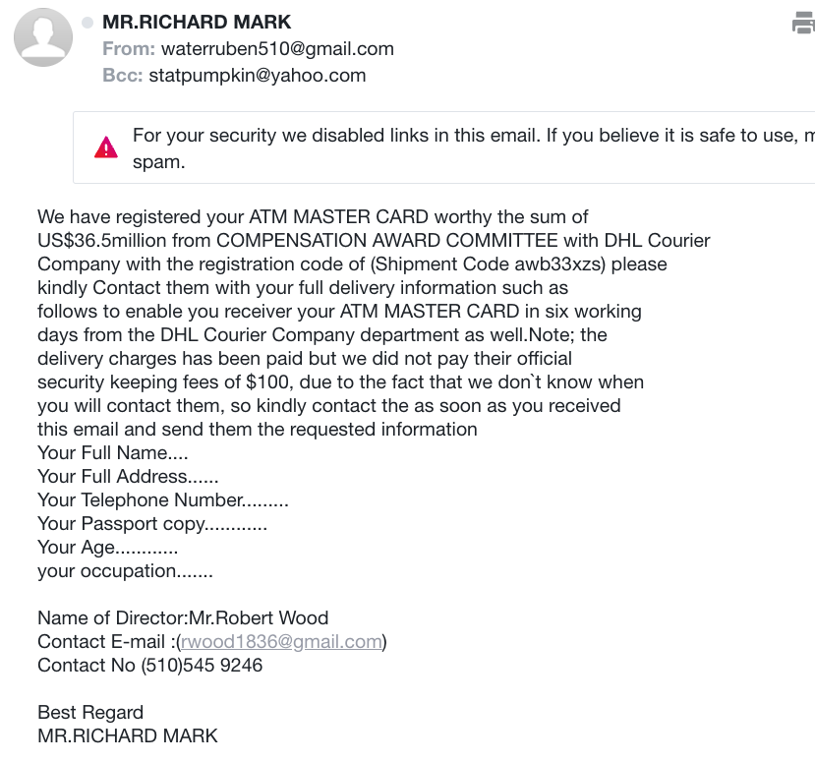
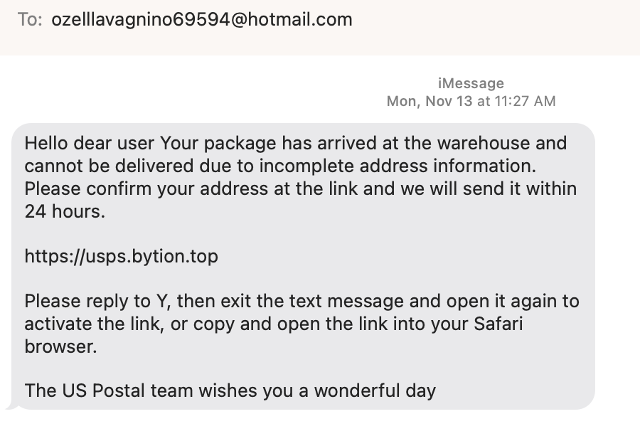
Motivating example: Spam
Recently in my email:
Recently in my texts:
What is the business problem?
What is the data science problem?
What are the costs/benefits?
How would you set a threshold?
What action would you take?
Notes:
Ask them how they think we can detect this as spam

Slide 3
Overview of Text Mining
Automatically extracting meaning from a document
Label a document into one of many known types
E.g. Library categorization
Multi-class classification
Clustering documents into useful groups
Unsupervised learning
Query a set of documents for search or to find most similar ones
E.g. legal precedent, patent searches
Text-based learning often requires a large collection of documents to learn from – a corpus - that needs to be pre-processed significantly before analysis.

Slide 4
Text Analysis is Hard!
“Boston beat San Francisco in the game last night” vs “San Francisco beat Boston in the game last night”
“Hitchcock shot The Birds in Bodega Bay”
“Lets eat, Grandma!”
“I can’t recommend this person highly enough”
Text is more than just words, and understanding language (NLP) is a technical field all to itself…but we have to start somewhere!

Slide 5
Representing Text for Data Science

Slide 6
Preparing Text for Modelling
Description | Loan Default
This loan request is to reduce credit card debt by receiving a more manageable finance charge and payment schedule than what I am currently paying on a monthly basis. I currently meet all my financial obligations without problems. This allows quicker debt reduction. | 0
This loan will lower my interest rate on about $7000 of debt by 2 percentage points! I have qualified for this great rate by having an outstanding credit score over the last 20 years. Thank you for helping to fund me.<br><br> This short term loan will allow me to lower my interest rate by 2 percentage points. I have qualified for a great rate due to my solid credit score, etc. Thank you for helping me to achieve my goals. | 0
To be financially stable within 3 years. Pay off all bills and concentrating on paying off my house within 10 years of my plan. | 0
To consildate credit card debt | 0
To consolidate bills for one monthly payment.<br><br> To pay off credit card debt and have one monthly payment.<br> | 0
To consolidate credit card bills and be debt free in 5 years<br> | 1
To consolidate credit card debt.<br><br> My loan is to consolidate credit card debt and simplify my payments,<br> | 1
To consolidate some credit cards and assist my son who is graduating from college relocate to the Washington DC area where he has accepted a full time job.<br> | 0
Notes:
How do we get this in a form ready for DS?
Feature engineering!!
Also remind them of the spam example…

Slide 7
Text Mining: Processing
Language is notoriously messy!!! Looking at every word as its own entity might not make sense!
Not all words are important
Some words mean the same thing
Tenses
Long tail!
Spelling!
Phrases that might not make sense to break up : “data science” “double play”
…but we have to start somewhere …

Slide 8
Text Mining: Processing
Pre-processing steps for text:
Remove symbols and punctuation
Stop-word removal
(the, is, in, a, at, for, where, when)
But be careful - “not”, “very”, and ”the” can be important (e.g. “The Batman”)
Case correction
Stemming – eliminate suffixes from words
“walking”,”walk”,”walked”,”walks” => “walk”
“lemmatizing” can go further (“see”,”saw”)
Spell correction
Tokenizing using subject matter expertise
E.g. “double play” => “double-play”
Remove rare words
Words that occur only once might overfit
Synonym lookup and replacement
(“Travel”, “vacation”, “trip”, ”journey”) => “travel”
from nltk.corpus import stopwords
String.lower()
from nltk.stem import PorterStemmer
pySpellChecker, JamSpell, textblob
Embeddings: word2vec (advanced!)
All of these can be domain specific!

Slide 9
Simplest method: Bag of Words
Each document is simply a bag of words (BoW)
Text: “This loan request is to reduce credit card debt by receiving a more manageable finance charge and payment schedule than what I am currently paying on a monthly basis. I currently meet all my financial obligations without problems. This allows quicker debt reduction.”
BAG:{without,what,to,this,this,than,schedule,request,reduction,reduce,receiving,quicker,problems,payment,paying,on,obligations,my,more,monthly,meet,manageable,loan,is,financial,finance,debt,debt,currently,currently,credit,charge,card,by,basis,and,am,allows,all,a,a,I,I}
This is known as tokenization: taking a document and reducing it to its terms
BoW is simple, convenient, but ignores:
Grammar
Word order
Sentence structure

Slide 10
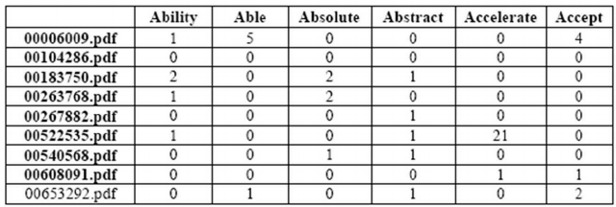
From unstructured to structured
After all of the counting and processing, we now have a structured Term Frequency (TF) data set for analysis - which words appear in which documents.
TF(d,t) = # of times term t appears in document d
Simple version – binary matrix – does word exist or not? (0,1)
…
…
Typically hundreds to thousands of columns…
…
…
…
Can be used for supervised or unsupervised
Good methods for supervised models:
Logistic regression (regularized for large feature space)
Naïve Bayes

Slide 11
Term-Frequency Table (TF)
Term-Frequency table
Can be normalized to account for the fact that some documents just have more words
To normalize, divide each number by the words in its own document
But how do we account for some terms being more frequent/important than others?
“LeBron” is more important than “James” in determining context
A term that is too common is not distinguishing, and therefore not useful for classification or clustering (stopwords, but others too)

Slide 12
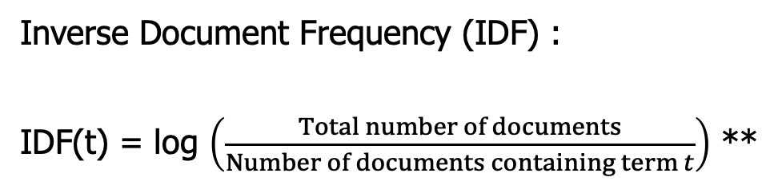
Inverse Document Frequency (IDF)
Concept:
The fewer documents a word appears in, the more significant it is when it does appear!
Inverse Document Frequency (IDF) :
IDF(t) = log $\left(\frac{Total number of documents}{Number of documents containing term t}\right)$ **
** Note: DSB book has a slightly different version of IDF
IDF is the boost a term gets for being rare
Rare terms have high IDF

Slide 13
Representing Text: TFIDF
A term is important for a given document if it has:
high term frequency (it appears a lot)
high IDF (it doesn’t appear in other documents as much)
We combine the TF and IDF matrix by multiplying them:
TFIDF(d,t) = TF(d,t) x IDF(t)
High values of TFIDF(d,t) mean that term t has importance in the context of document d.

Slide 14
NLP using TFIDF
TF-IDF matrices are the vehicle for doing ML on collections of text
Once you have a TFIDF matrix, you can now think about doing
Classification
Clustering
Similarties between documents
Search
from sklearn.feature_extraction.text import TfidfVectorizer
Options:
strip_accents
stop_words
ngram
max_df
min_df
…
See documentation

Slide 15
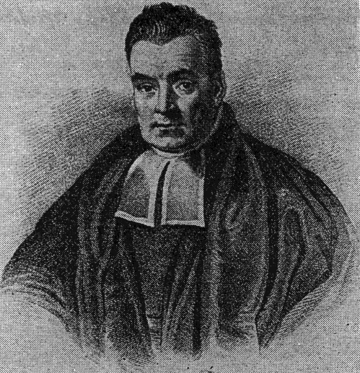
Naïve Bayes:
A classification model for text analytics

Slide 16
Recall : Conditional Probability
For any two events A and B:
P(A|B) = P(A AND B) / P (B)
P(A AND B) = P(A|B) x P(B)

Slide 17
Recall : Conditional Probability
For any two events A and B:
P(A|B) = P(A AND B) / P (B)
P(A AND B) = P(A|B) x P(B)
70% of customers at a movie theatre buy drinks. Of those that buy drinks, 30% also buy popcorn. What % of the audience buys drinks and popcorn?
A=drinks
B=popcorn
P(A) = .70
P(B|A) = .30
P(B and A) = P(B|A) x P(A) .7 x .3 = .21 (21%)

Slide 18
Recall : Conditional Probability
For any two events A and B:
P(A|B) = P(A AND B) / P (B)
P(A AND B) = P(A|B) x P(B)
Accept Offer?
 | YES | NO | Totals
Phone Call | 25 | 75 | 100
Text | 125 | 175 | 300
Email | 125 | 475 | 600
Totals | 275 | 725 | 1000
Marketing Channel
What is the probability of acceptance given channel = Email?
Notes:
= P(Acceptance | Channel is Text) = P(Accept AND Channel is Text) / P(Channel is text) = 125/1000 / 300/1000 = 125/300 = 42%

Slide 19
Bayesian Statistics
Thomas Bayes came up with Bayes’ Rule in the 1800s by just turning around the rules of probability
P(A AND B) = P(A|B) x P(B)
P(A AND B) = P(B|A) x P(A)
Then:
P(A|B) = P(B|A) x P(A) / P(B)
Bayes’ Rule
Typically in DS (or stats) we are trying to find the probability of some outcome (A) given some data (B)
Bayes’ Rule allows us to flip this….
Notes:
Bayesians have priors…

Slide 20
So What??
Example
Customer | Age | Income | No. credit cards | Response
John | 35 | 35K | 3 | Yes
Charlene | 22 | 50K | 2 | No
Rayshawn | 63 | 200K | 1 | No
Ping | 59 | 170K | 1 | No
Nellie | 25 | 40K | 4 | Yes
Predictive models are really just conditional probabilities…
P(Yes | Age=25, Income=40k, credit cards = 4, …)
= P(Yes | features)
= P(features | Yes) x P(Yes) / P(features)
This is the Bayes part…

Slide 21
Applying Bayes’ Rule in Data Science
Now we have reduced the problem to calculating:
P(features | Yes) x P(Yes) / P(features)
Now we make an assumption – a naïve assumption – that the features are conditionally independent:
P(features | Yes) = P(f₁|Yes) x P(f₂|Yes) x … x P(f_{k}|Yes)
These components are usually easily calculated from training data
This is the Naïve part…

Slide 22
Getting back to spam…
Text | Spam?
a l c | 1
b c d | 0
c e k | 1
a c d | 1
c f g | 1
a c d | 0
a b c | 1
b d f | 0
New Case to classify “a b d”
P(Spam=1| “a b d”) ?
Notes:
note complications with new case – values not present in training data

Slide 23
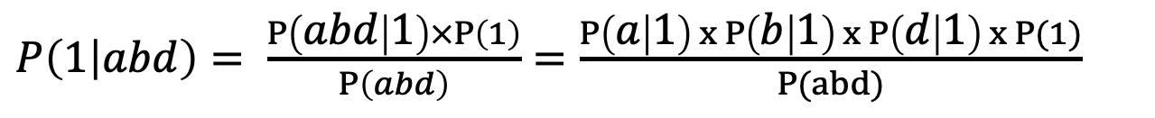
Using Bayes’ Rule
P( abd | Spam=1) x P(Spam=1)
P(Spam = 1 | abd ) =
P(abd )
Text | Spam
a l c | 1
b c d | 0
c e k | 1
a c d | 1
c f g | 1
a c d | 0
a b c | 1
b d f | 0
Problem: we have never seen ‘a-b-d’
But: we have seen ’a’, ‘b’, ‘d’ …
conditional independence
$P\left(1 | abd\right)= \frac{P\left(abd | 1\right)×P\left(1\right)}{P\left(abd\right)}=\frac{P\left(a | 1\right) x P\left(b | 1\right) x P\left(d | 1\right) x P(1)}{P(abd)}$

Slide 24
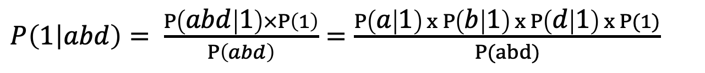
Naïve Bayes
$P\left(1 | abd\right)= \frac{P\left(abd | 1\right)×P\left(1\right)}{P\left(abd\right)}=\frac{P\left(a | 1\right) x P\left(b | 1\right) x P\left(d | 1\right) x P(1)}{P(abd)}$
Can all be calculated directly from the data!
P(a|1) = 3/5
P(b|1) = 1/5
P(d|1) = 1/5
P(1) = 5/8
Text | Spam
a l c | 1
b c d | 0
c e k | 1
a c d | 1
c f g | 1
a c d | 0
a b c | 1
b d f | 0

Slide 25
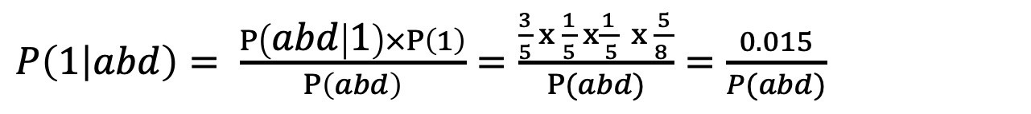
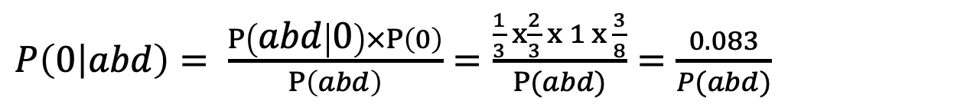
So, what is probability of Spam=1?
Text | Spam
a l c | 1
b c d | 0
c e k | 1
a c d | 1
c f g | 1
a c d | 0
a b c | 1
b d f | 0
$P\left(1 | abd\right)= \frac{P\left(abd | 1\right)×P\left(1\right)}{P\left(abd\right)}=\frac{\frac{3}{5} x \frac{1}{5} x\frac{1}{ 5} x \frac{5}{8 }}{P(abd)}=\frac{0.015}{P(abd)}$
$P\left(0 | abd\right)= \frac{P\left(abd | 0\right)×P\left(0\right)}{P\left(abd\right)}=\frac{\frac{1}{3} x\frac{2}{3} x 1 x \frac{3}{8}}{P(abd)}=\frac{0.083}{P(abd)}$
P(1|abd) and P(0|abd) both have P(abd) in the denominator – which cancels out - allowing you to calculate relative probabilities of spam vs. no-spam
Notes:
Two important things here:
- The “conditional flip” plus the “conditional independence” are the two things that make this work.

Slide 26
Why Naïve Bayes for text??
The conditional independence probability is very useful for text
We have probably never seen that specific collection of words before
BUT we have seen each word independently in both scenarios
The individual probabilities are very easy to calculate
Just counting when they occur
Naïve Bayes can be used for any predictive problem!
BUT the features have to be nominal categoricals (like words!)
If you have numerical features, you can run NB by binning them
But you lose the ordering…have to treat them like nominal…
Discussion: DSB p261
Types of NB | Usage
BernoulliNB | Uses Term Occurrence (Binary)
MultinomialNB | Works with raw term frequencies
GaussianNB | Assumes continuous features and normality, not typically used for text
ComplementNB | Best for unbalanced data and TFIDF

Slide 27
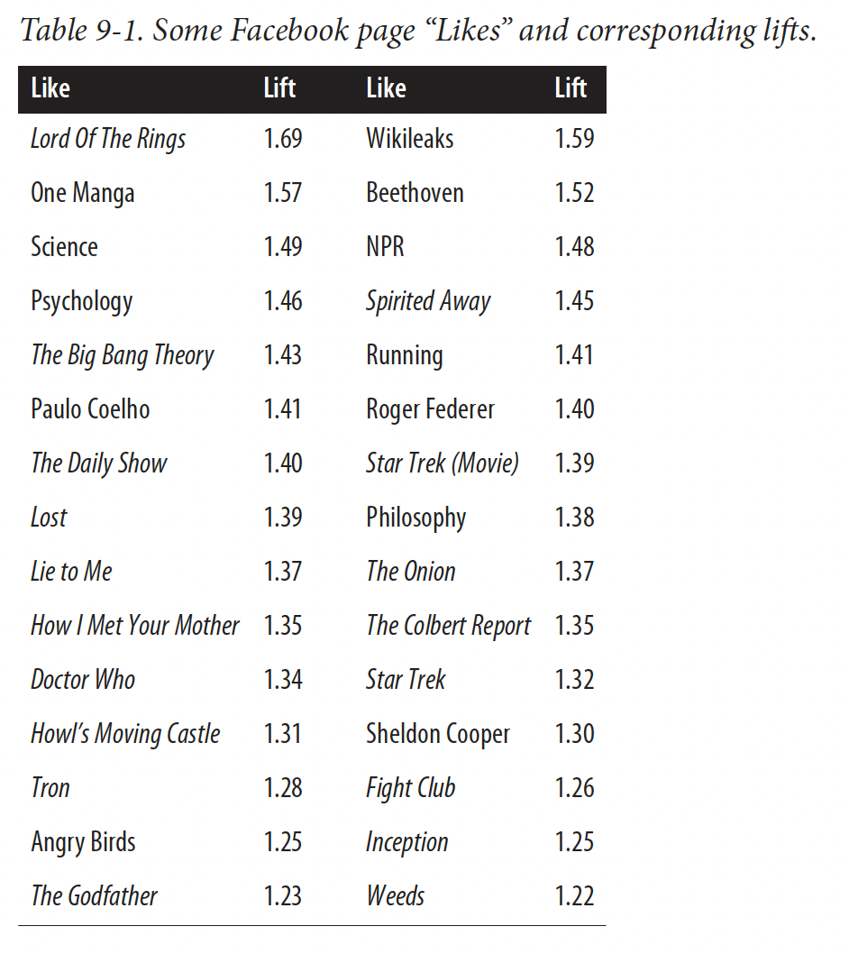
Naïve Bayes Example
DSB p 264
“High IQ” from the PNAS paper
“Likes” are like words
Binary
there are many of them
they are discrete
NB provides a “lift” - the increase in probability given the presence of the feature
Kosinski, et al 2013
Notes:
This difference is important: the act of clicking “Like” on a page is different from simply liking it, and the data we have are on the former and not the latter. It is also important to consider that this is an act of public signaling: a Facebook user is openly declaring to friends that they like something, and the rea‐ sons for this may not be obvious.11

Slide 28
Using TFIDF / Naïve Bayes
T8_Text_Mining.ipynb

Slide 29
NLP: Other Topics
import nltk
import spacy
Gen AI???
Notes:
The stuff you just learned just scrathes the surface of NLP, now I will go rapid fire through some other topics…

Slide 30
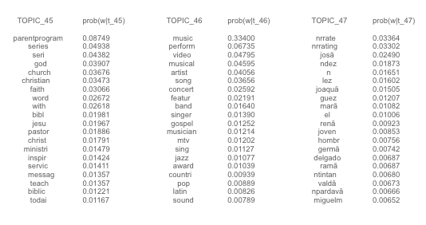
Topic Modelling – LSA/LDA, etc
“topic modelling” is a way of doing unsupervised learning on a set of documents (corpus)
Think of it as a clustering exercise
Similar to Principal Components: reduced dimensions define “topics”
Typically starts with the TFIDF matrix
Extracts “topics” by finding clusters of words
Methods find “latent” topics
Latent Semantic Indexing (LSI)
Latent Dirichlet Analysis (LDA)
Non-negative Matrix Factorization (NMF)
LDA applied to TV program data

Slide 31
Named Entity Recognition
Move us away from Bags of Words and toward understanding of the data
Knowing what are the proper nouns and names can go a long way to extracting meaning from text
In fact : entities can be very helpful in topic modelling
Christopher Robin is alive and well. He is the same person that you read about in the book, Winnie the Pooh. As a boy, Chris lived in a pretty home called Cotchfield Farm. When Chris was three years old, his father wrote a poem about him. The poem was printed in a magazine for others to read. Mr. Robin then wrote a book

Slide 32
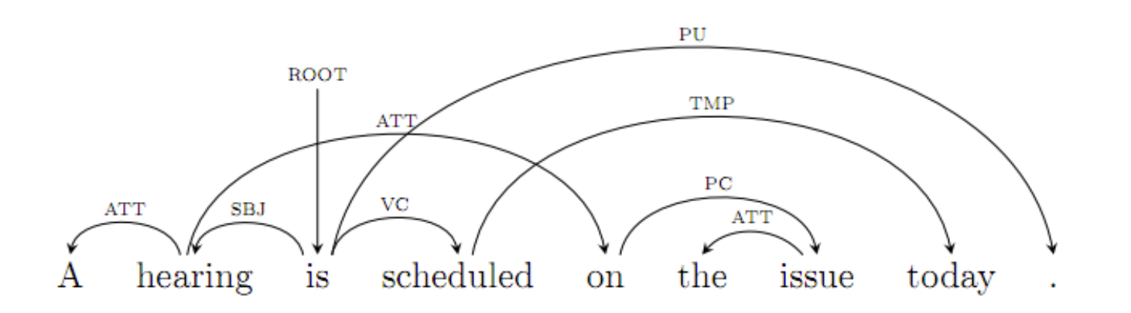
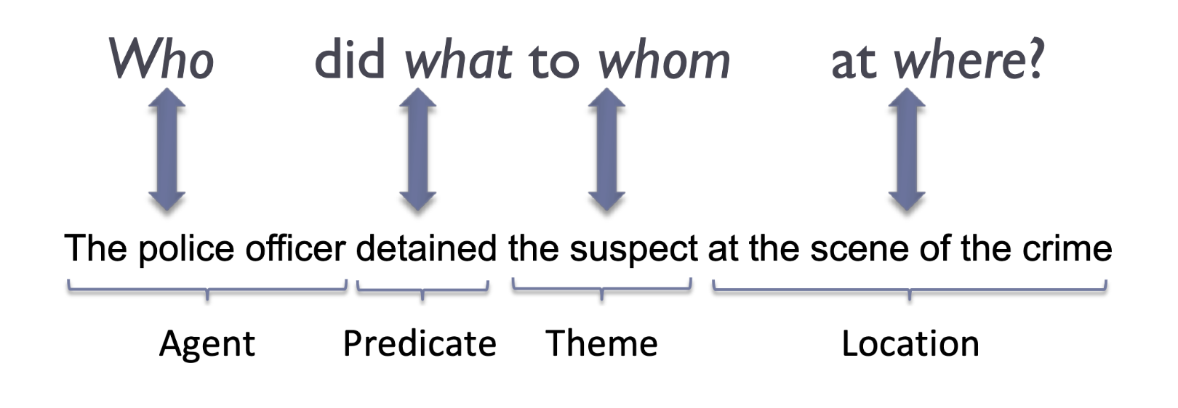
Part of Speech Detection
Natural Language parsing (PoS) attempts to deconstruct language into parts of speech to truly try to understand the meanings of sentences:
Import pos_tag from nltk
Courtesy https://ift6758.github.io/lectures/NLP_part1.pdf
Notes:
This requires a lot of specialized training data and a lot of computational power.

Slide 33
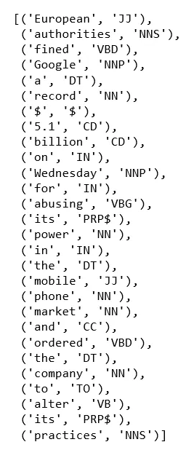
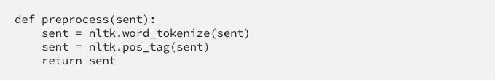

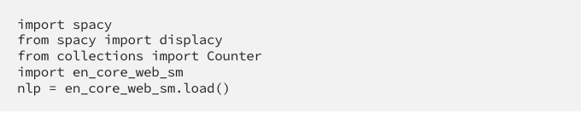
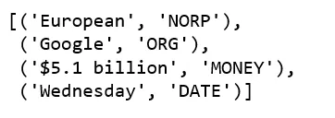
PoS / NER in python
https://towardsdatascience.com/named-entity-recognition-with-nltk-and-spacy-8c4a7d88e7da

Slide 34
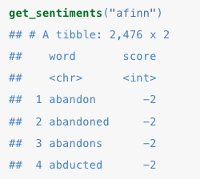
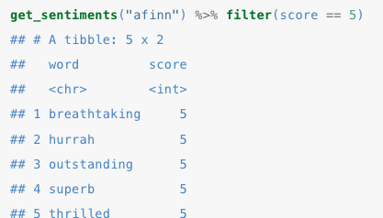
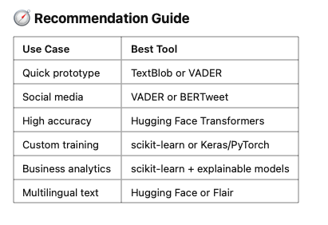
Sentiment Analysis
Many applications attempt to automatically identify text as positive or negative, based on the words used.
This is hard!
“this movie was not a total waste of time!”
“reading this book was so engrossing it destroyed my desire to do anything else”
Nonetheless, we can use:
Existing lists of good:bad words (e.g. AFINN)
Labeled corpuses from existing domains as training data
from nltk.corpus import movie_reviews as reviews
So many tools..
Notes:
Afinn is +5 to -5
-5 is REALLY bad

Slide 35
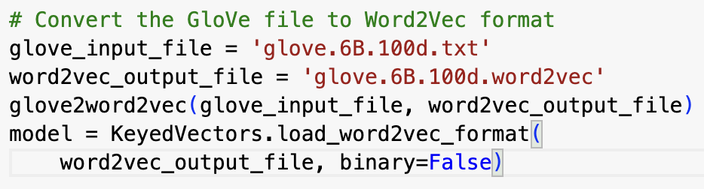
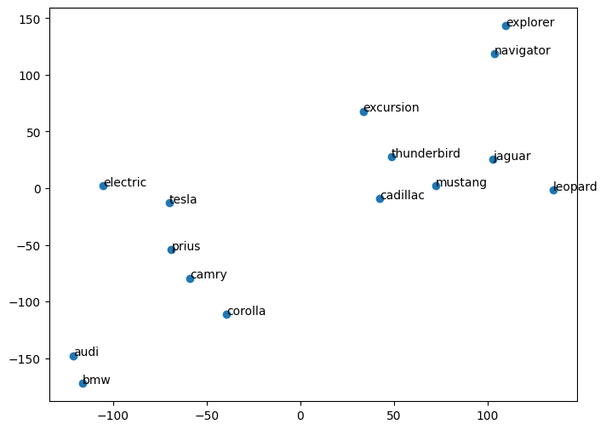
Embeddings
Embeddings are a fairly recent approach to NLP
An alternative to TFIDF
Words are “embedded” into a multidimensional space, so that they are near other words of similar meaning or common context
Embeddings are learned from training data
Embeddings.ipynb
“espresso song” is associated with “Sabrina Carpenter” even though there are no words in common.
Embeddings place words in a multi-dimensional space so that similar words are together (happy ⬄ joyful) but words can also have multiple meanings (BMW ⬄ Jaguar ⬄ leopard).
Pre-trained word embeddings you can use:
Word2vec
gloVe
BERT
Notes:
. Magic of embeddings is that they are not trained by knowing the definition of words, they simply are trained on gobs of text.
BERT can look at the entire sentence and not just adjacent words – it is one of the foundations of modern generative AI tools.

Slide 36
Topic Modelling
T8_SOTU.ipynb

Slide 37
Text / NLP : Summary
Text is Data! 📊
TF/IDF enables you to use your toolbox
Pre-processing text is important for success 👩‍💻
Text is messy!
Removing punctuation, numbers, stopwords; stemming, tokenization
Naïve Bayes
A new tool for your toolbox 🧰
Built from conditional probability
Naïve (conditional independence of terms) + Bayes (flip the conditional)
Many applications 📱
Clustering/topic modelling
Summarization
Sentiment

